Slide 1
Database Security
Prepared By: Amrin Shaikh

Slide 2
Outline
Views - What are views for? View retrievals, View updates, Snapshots (a digression), Materialized view.
Security – Security and Authentication, authorization in SQL, Data encryption

Slide 3
View
Views are virtual only and run the query definition each time they are accessed.
It is a logical view of your tables, with no data stored anywhere else.
Views are essentially logical table-like structures populated on the fly by a given query. The results of a view query are not stored anywhere on disk and the view is recreated every time the query is executed
Create view Syntax:
CREATE or replace VIEW view_name AS SELECT columns FROM table WHERE conditions;
Example: create view a_view as select * from a_student;

Slide 4
A View in Oracle and in other database systems is simply the representation of a SQL statement that is stored in memory so that it can easily be re-used. For example, if we frequently issue the following query
SELECT customerid, customername FROM customers WHERE countryid='US';
To create a view use the CREATE VIEW command as seen in this example
CREATE VIEW view_uscustomers AS SELECT customerid, customername FROM customers WHERE countryid='US';
This command creates a new view called view_uscustomers. Note that this command does not result in anything being actually stored in the database at all except for a data dictionary entry that defines this view. This means that every time you query this view, Oracle has to go out and execute the view and query the database data. We can query the view like this:
SELECT * FROM view_uscustomers WHERE customerid BETWEEN 100 AND 200;
And Oracle will transform the query into this:
SELECT * FROM (select customerid, customername from customers WHERE countryid='US') WHERE customerid BETWEEN 100 AND 200;

Slide 5
Benefits of using Views
Commonality of code being used. Since a view is based on one common set of SQL, this means that when it is called it’s less likely to require parsing.
Security. Views have long been used to hide the tables that actually contain the data you are querying. Also, views can be used to restrict the columns that a given user has access to.

Slide 6
View Retrieval/ Update
This Oracle CREATE VIEW example would create a virtual table based on the result set of the SELECT statement. You can now query the Oracle VIEW as follows:
select * from a_view;
You can modify the definition of an Oracle VIEW without dropping it by using the Oracle CREATE OR REPLACE VIEW Statement
CREATE OR REPLACE VIEW view_name AS SELECT columns FROM table WHERE conditions;
create or replace will update view if view exists, if doesn’t then it creates a view
Example: create or replace view a_view1 as select sid from a_student where sid>=102;

Slide 7
Drop View
To drop a created view
drop view view_name;
Example: drop view a_view1;
Question: Can you update the data in an Oracle VIEW?
Answer: A VIEW in Oracle is created by joining one or more tables. When you update record(s) in a VIEW, it updates the records in the underlying tables that make up the view. So, yes, you can update the data in an Oracle VIEW providing you have the proper privileges to the underlying Oracle tables.

Slide 8
Snapshot
A snapshot is a replica of a target master table from a single point in time. Whereas in multi-master replication tables are continuously being updated by other master sites, snapshots are updated from one or more master tables through individual batch updates, known as a refreshes

Slide 9
Materialized View
Materialized view (MV) is indirect access to table data by storing the result of a query in a separate schema object.
It can be stored in the same db or in different db.
MV stored in same db as their master tables can improve performance through query rewrite. For queries that involve aggregate data or join the optimizer can rewrite the query to access the precomputed results stored in MV.
Query rewrite is particularly useful in data warehouse.
Another name of mv is snapshot.
MV are schema object that is used to summarize, precompute, replicate, distribute data.
Suitable in data warehouse, decision support, distributed & mobile computing.
They consume storage
Must be refreshed when data in master table changes.
Their existent is transparent to sql application & user.
Having limitation: support for incremental refresh.

Slide 10
Limitation & Syntax of Materialized View
Support for incremental refresh is limited.
Syntax
CREATE MATERIALIZED VIEW view-name
BUILD [IMMEDIATE | DEFERRED]
REFRESH [FAST | COMPLETE | FORCE ]
ON [COMMIT | DEMAND ]
[[ENABLE | DISABLE] QUERY REWRITE]
[ON PREBUILT TABLE]
AS
SELECT ...;

Slide 11
The BUILD clause options are shown below.
IMMEDIATE : The materialized view is populated immediately.
DEFERRED : The materialized view is populated on the first requested refresh.
The following refresh types are available.
FAST : A fast refresh is attempted. If materialized view logs are not present against the source tables in advance, the creation fails.
COMPLETE : The table segment supporting the materialized view is truncated and repopulated completely using the associated query.
FORCE : A fast refresh is attempted. If one is not possible a complete refresh is performed.
A refresh can be triggered in one of two ways.
ON COMMIT : The refresh is triggered by a committed data change in one of the dependent tables.
ON DEMAND : The refresh is initiated by a manual request or a scheduled task.
The QUERY REWRITE clause tells the optimizer if the materialized view should be consider for query rewrite operations.
The ON PREBUILT TABLE clause tells the database to use an existing table segment, which must have the same name as the materialized view and support the same column structure as the query

Slide 12
Create materialized view
Example:
create materialized view a_mv1 build immediate refresh fast on commit as select sid from a_student;
Error: ORA-01031: insufficient privileges, on a_student
It's easier to GRANT or REVOKE privileges to the users through a role rather than assigning a privilege directly to every user. If a role is identified by a password, then, when you GRANT or REVOKE privileges to the role, you definitely have to identify it with the password.

Slide 13
Authentication vs Authorization
Authentication | Authorization
Authentication verifies who you are | Authorization verifies what you are authorized to do.
For example, you can login | For example, you are allowed to login into your Unix server via ssh client, but you are not authorized to browser /data2 or any other file system.
 | Authorization occurs after successful authentication
 | Authorization can be controlled at file system level or using various application level configuration
Authentication: I am an employee of the company. Here is my ID badge. | Authorization: As an employee of the company, I am allowed entrance into the building.

Slide 14
Data Encryption
Data encryption is the act of changing electronic information into an unreadable state by using algorithms or ciphers.
Over time as the public has begun to enter and transmit personal, sensitive information over the internet, data encryption has become more widespread

Slide 15
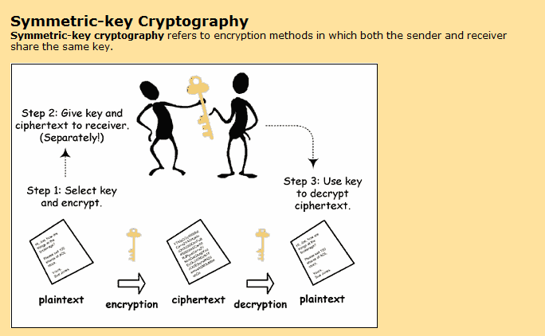

Slide 16
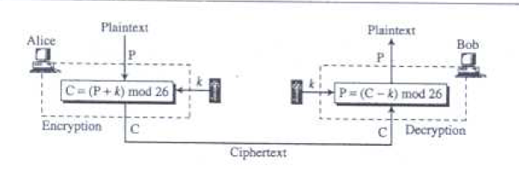
Additive cipher
Plain text: what |  | Key: 20 Encryption | Cipher Text: qbun | Key: 20 Decryption | Plain text: what
PT: w | 22 | 22+20=42%26=16 | CT: q | 16-20=-4%26 = 22 | PT: w
PT: h | 7 | 7+20=27%26=1 | CT: b | 1-20=-19%26=7 | PT: h
PT: a | 0 | 0+20=20%26=20 | CT: u | 20-20=0%26=0 | PT: a
PT: t | 19 | 19+20=39%26=13 | CT: n | 13-20=-7%26=19 | PT: t
Also known as shift or caesar cipher
Brute Force or statistical attacks are possible to cryptanalyse

Slide 17
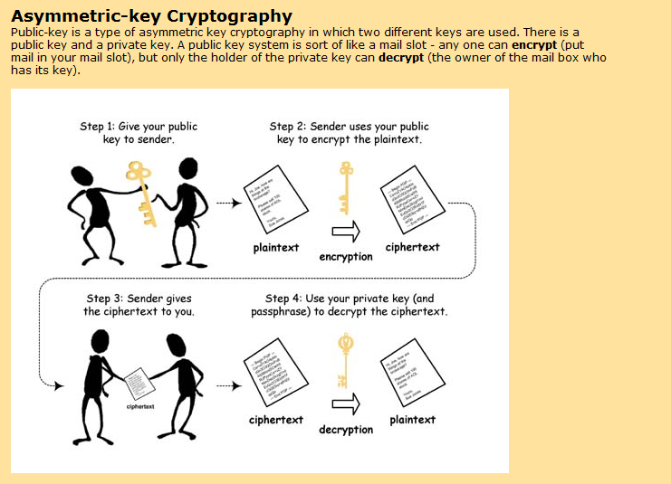

Slide 18
RSA
Let p = 11, q = 13
n = pq = 143
phi(n)= (p-1)(q-1) = 120 = 3 x 23 x 5
Possible e: 7, 11, 13, 17, … (let’s use 7)
Find d: 7*d = 1(mod 120) = 103 e*d=1 mod phi(n)
Public key: (7, 143)
Private key: (103, 143)
Message=h=7
En(42) = 7^7 (mod 143) = 6
De(81) = 6^103(mod 143) = 7

Slide 19
Thank You

